Slide 1

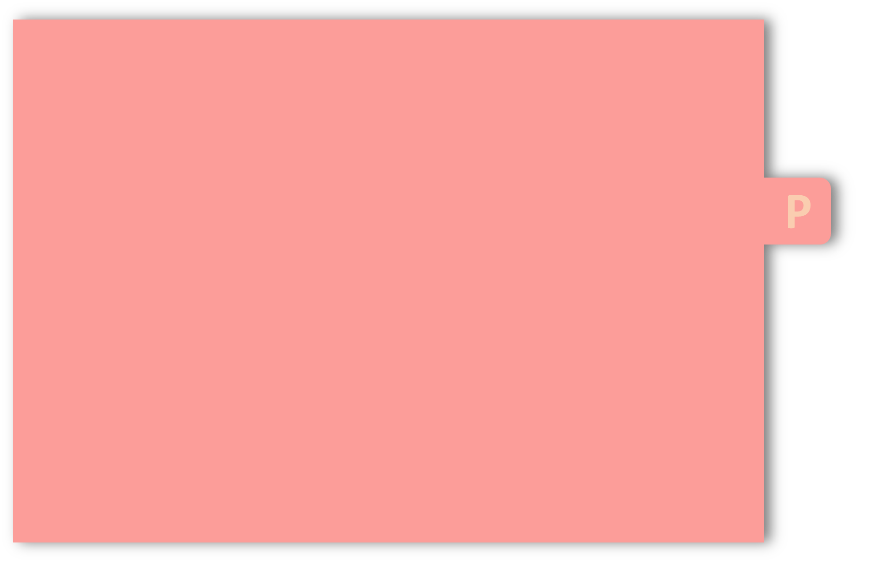
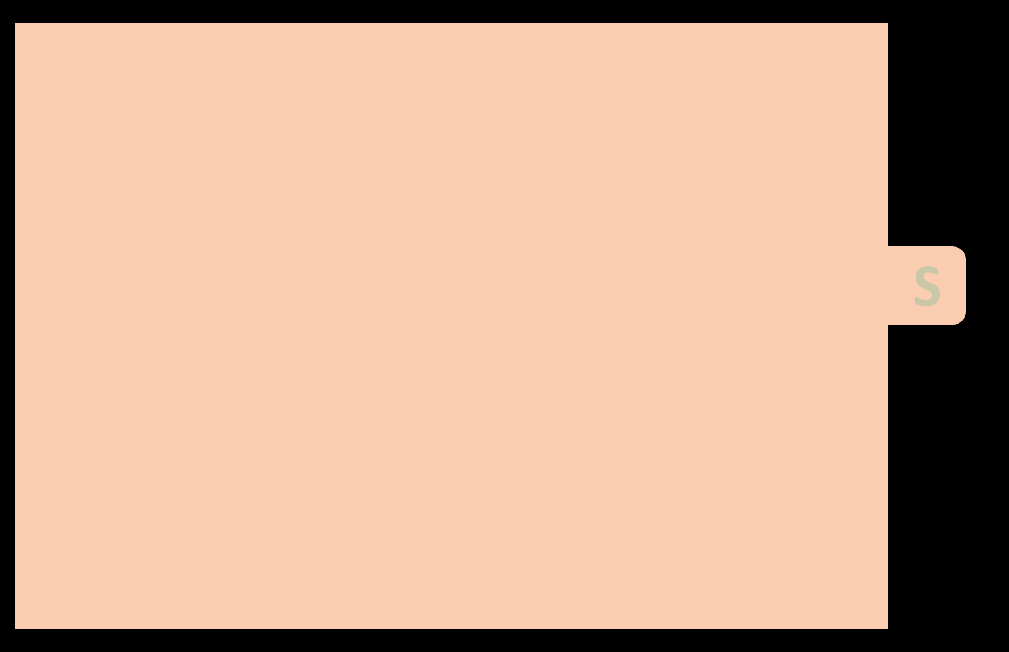
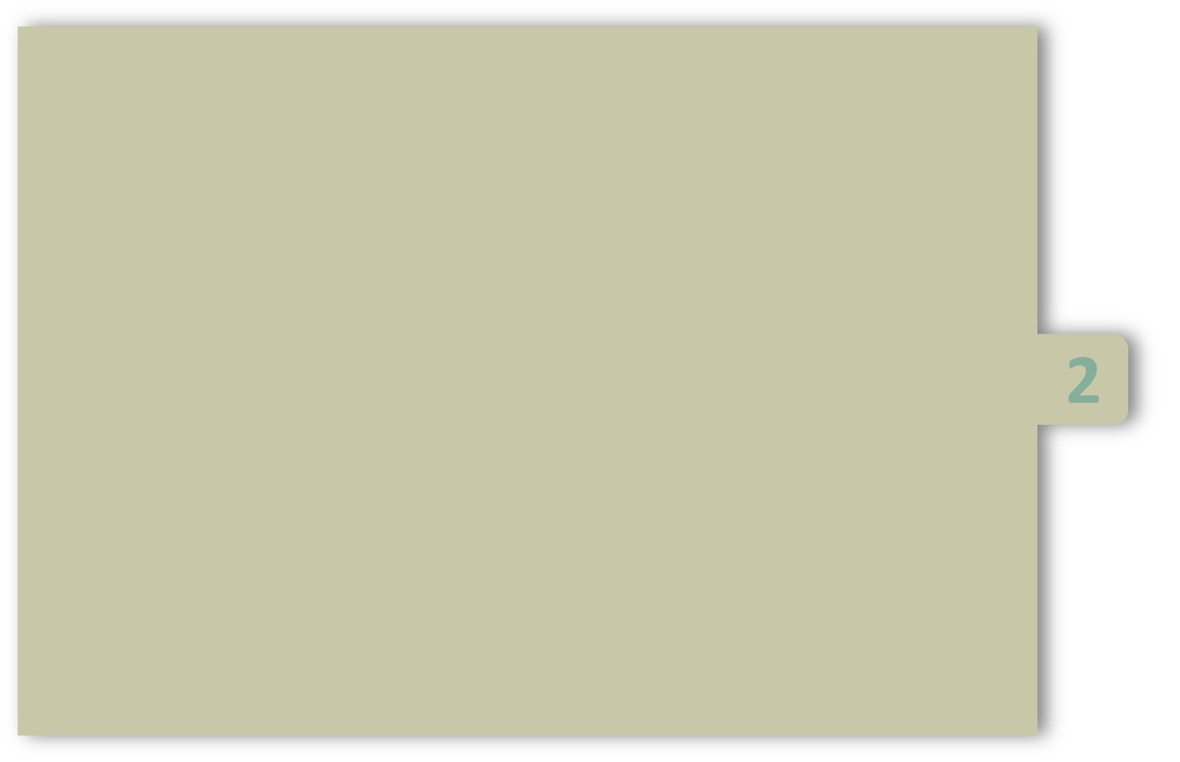
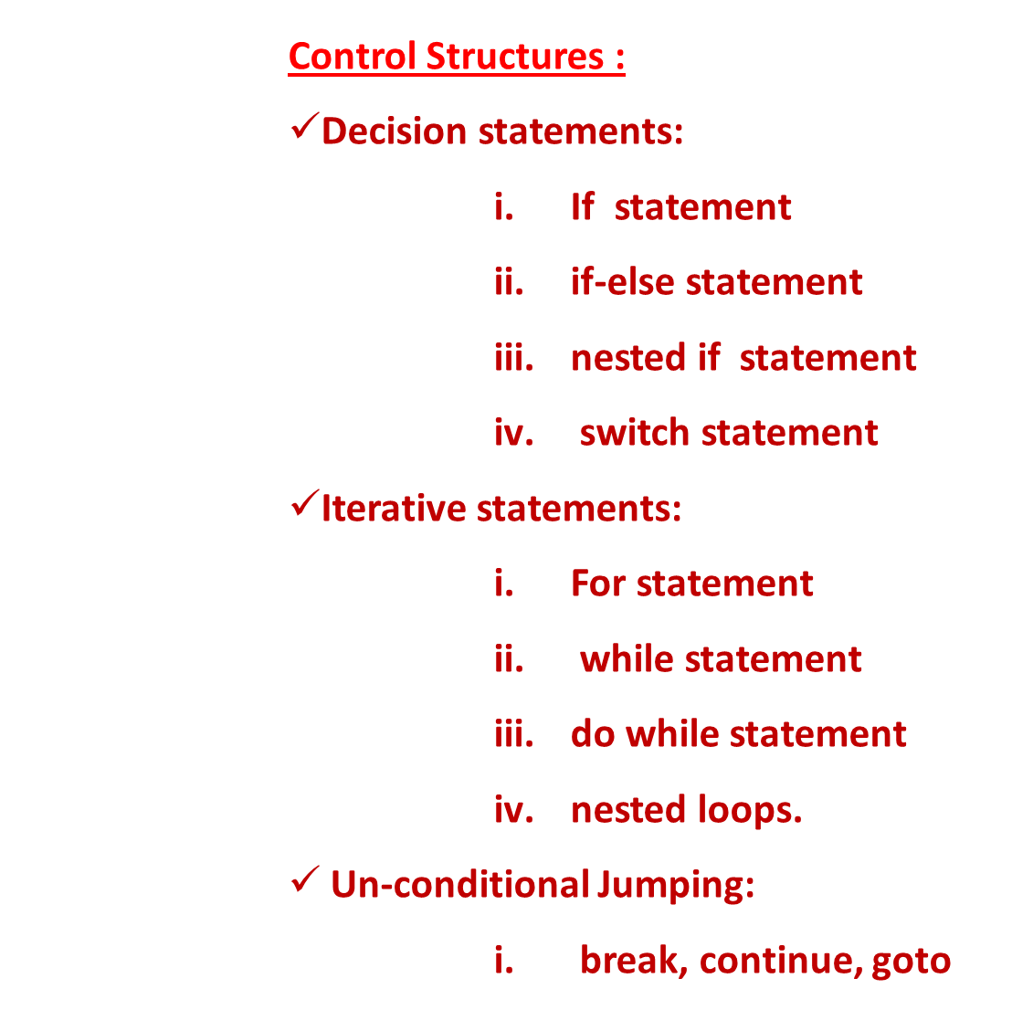
UNIT-2
PRESENTED BY
Dr. Jagadeesh Kakarla
CSE, IIITDM Kancheepuram

Slide 2
Control structure
Def of Control structure:
A statement that is used to control the flow of execution in a program is called control structure.
Types of control structures
i.Sequence:
sequential flow – straight line path – default mode
ii.Selection:
conditional flow – choosing between 2 or more alternative paths – one or many branches iii.Iteration:
Repetitive flow – repeating a piece of code multiple times in a row – used for looping

Slide 3
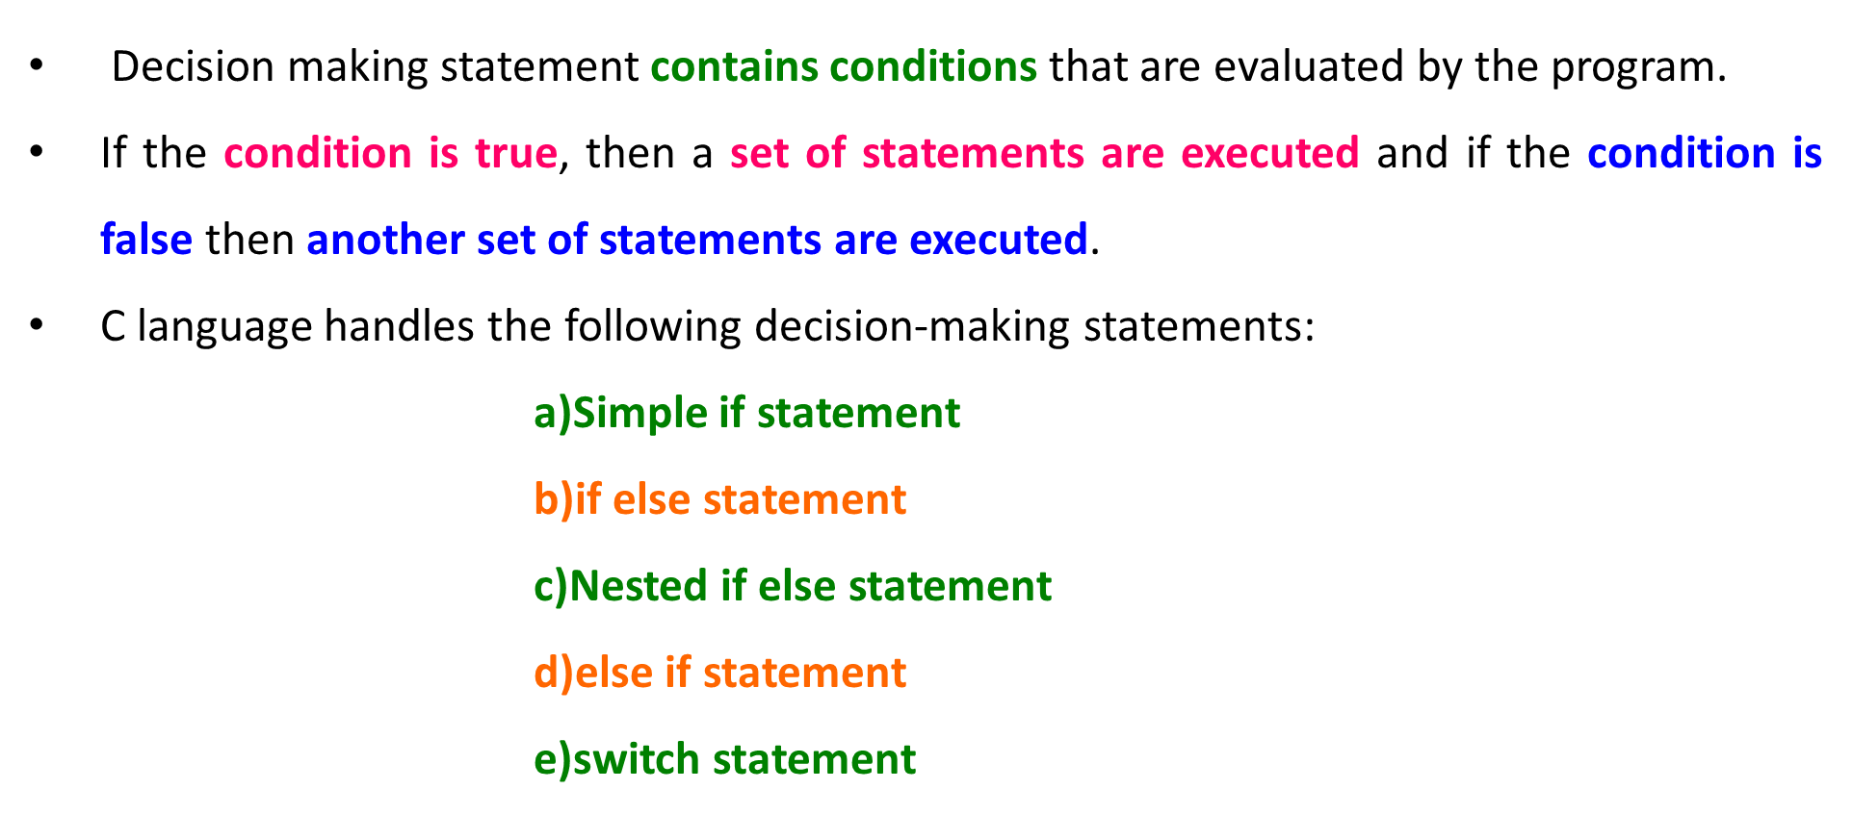
Selection statements
(Decision making statements –Branching statements)

Slide 4
a)Simple if statement
The if statement is a powerful decision making statement which can handle a single condition or group of conditions. They may be either true or false.
If the condition true, then the statement-inside and statement-outside the if block will be executed.
If the condition false, then statement-inside the if is skipped and only the statement-outside the if block is executed
Syntax
if(condition)
{
statement inside;
}
statement outside;

Slide 5
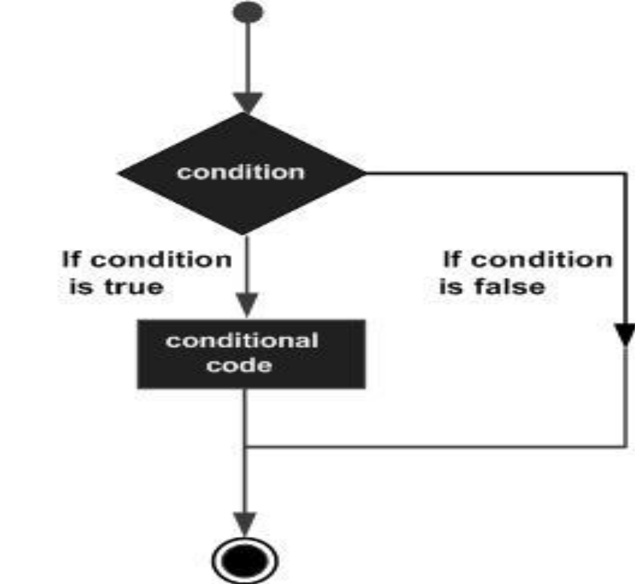
a)Simple if statement
void main( )
{
int x, y;
x = 15;
y = 13;
if (x > y )
{
printf("x is greater than y");
}
}
Output: x is greater than y

Slide 6
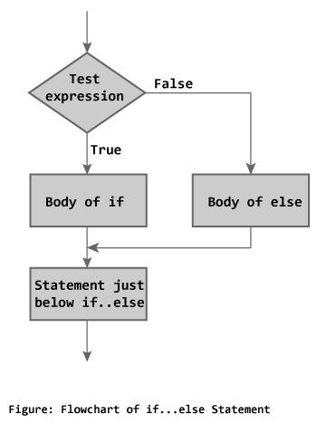
b)if else statement
This statement also has a condition with two different blocks.
One is true block and other is false block.
void main( )
{
int x = 15, y = 18;
if (x > y )
printf("x is greater than y");
else
printf("y is greater than x");
}
Output: y is greater than x
Syntax
if(condition)
{
statement block1;
}
else
{
statement block2;
}

Slide 7
c) Nested if else statement
When an if statement occurs within another if statement, then such type of is called nested if statement.
if conditon-1 and conditon-2 is true then statement block1 will be executed.
If conditon-1 is true and conditon-2 is false then statement-block2 will be executed.
if conditon-1 is false then statement block3 will be executed.
Syntax
if(conditon-1 )
{
if(conditon-2)
{
statement block1;
}
else
{
statement block2;
}
}
else
{
statement block3;
}

Slide 8
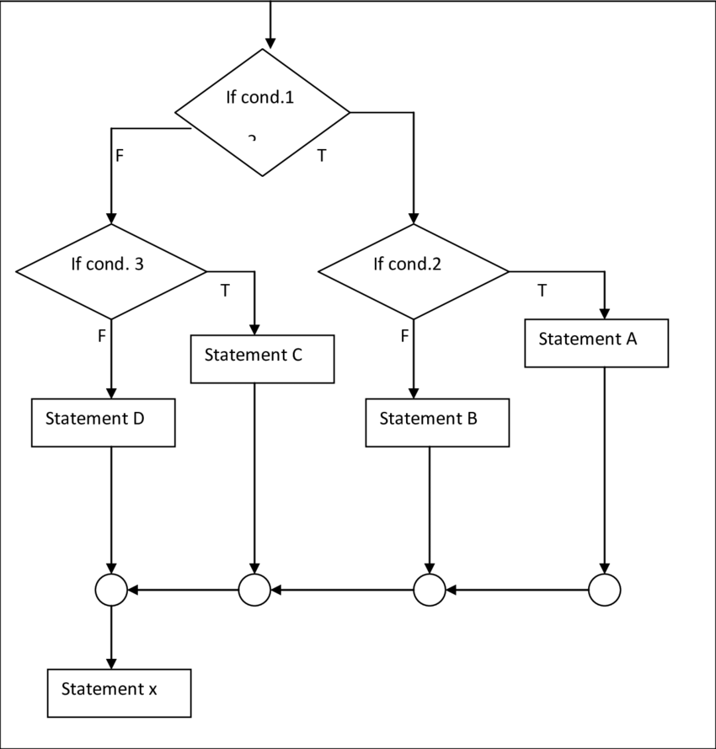
c)Nested if else statement
void main( )
{
int a, b, c;
printf("Enter 3 numbers: ");
scanf("%d%d%d",&a, &b, &c);
if(a > b)
{
if(a > c)
printf("a is the greatest");
else
printf("c is the greatest");
}
else
{
if(b > c)
printf("b is the greatest");
else
printf("c is the greatest");
}
}

Slide 9
d)else if ladder
When in a complex problem number of condition arise in a sequence, then we can use Ladder-if or else if statement to solve the problem in a simple manner.
Syntax:
if(ccondition-1)
{
statement block1;
}
else if(condition-2)
{
statement block2;
}
else if(condition-3 )
{
statement block3;
}
else
default statement;
if condition-1 is true, then statement block1 will be executed and remaining all blocks will not be executed.
If condition-1 is false, then statement block1 will not be executed and the condition-2 is tested.
The conditions are tested from the top to downwards. As soon as a true condition is found, the statement associated with it is executed.
If all the conditions are false, then the default block (else block) will be executed.

Slide 10
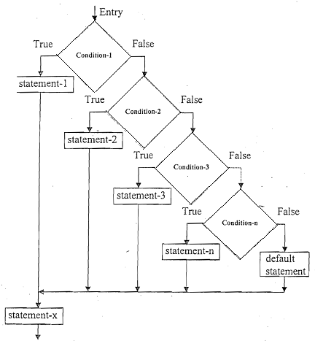
d)else if ladder
void main( )
{
int a;
printf("Enter a number...");
scanf("%d", &a);
if(a%5 == 0 && a%8 == 0)
printf("Divisible with by 5&8");
else if(a%8 == 0)
printf("Divisible by 8");
else if(a%5 == 0)
printf("Divisible by 5");
else
printf("Divisible by none");
}

Slide 11
e)Switch statement in C
Switch statement is a control statement that allows us to choose only one choice among the many given choices.
The expression in switch evaluates to return an integer value, which is then compared to the values present in different cases.
It executes that block of code which matches the case value. If there is no match, then default block is executed (if present).

Slide 12
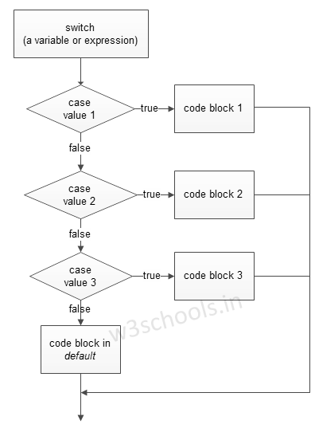
e)Switch statement in C
Syntax
switch(expression)
{
case value-1: block-1;
break;
case value-2: block-2;
break;
case value-3: block-3;
break;
default : default-block;
break;
}

Slide 13
Rules for using switch statement in C
The expression should be an integer or a variable or an expression that evaluates to an integer.
The case label values must be unique.
The case label must end with a colon(:)
break statements are used to exit the switch block.
It isn't necessary to use break after each block, but if you do not use it, then all the consecutive blocks of code will get executed after the matching block.

Slide 14
Rules for using switch statement in C
default case is executed when none of the mentioned case matches the switch expression.
The default case can be placed anywhere in the switch case. Even if we don't include the default case, switch statement works.
Nesting of switch statements are allowed, which means you can have switch statements inside another switch block.

Slide 15
void main( ) { int a=5, b=2, choice; printf("\n Enter your choice"); scanf("%d", &choice); switch(choice) { case 1: printf("%d", a+b); break; case 2: printf("%d", a-b); break; default: printf("you have passed a wrong key"); } } | void main() { char ch='b'; switch (ch) { case 'd': printf("CaseD "); break; case 'b': printf("CaseB"); break; case 'c': printf("CaseC"); break; default: printf("Default "); } }

Slide 16
Loops in C
A loop statement allows us to execute a statement or group of statements multiple times until a particular condition is satisfied.
In general, a loop consists of two components.
They are: a)Control statement b)body of the Loop
Control statement control the body of the loop.
Body of the loop consists of statements that we want to run more than one time.
loops are classified as 2-types.They are:
1)Entry Control Loop 2)Exit control Loop
i)while loop ii)do while loop
iii)for loop

Slide 17
i)while Loop
A while loop statement repeatedly executes a target statement as long as a given condition is true.
while loop can be addressed as an entry control loop.
Here, The loop iterates while the condition is true.
When the condition becomes false, program control passes to the line immediate statement after the loop.
The statement(s) block consists of single statement or a block of statements.

Slide 18
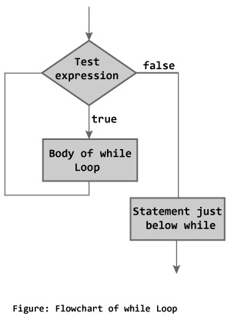
i)while loop
Syntax
variable initialization;
while(condition)
{
statements;
variable increment or decrement;
}
Example
void main( )
{
int a;
a = 1;
while(a <= 10)
{
printf("%d ", a); a++;
}
}
Output:
1 2 3 4 5 6 7 8 9 10

Slide 19
ii)do while loop
In some situations it is necessary to execute body of the loop before testing the condition.
Such situations can be handled with the help of do-while loop.
do statement evaluates the body of the loop first and at the end, the condition is checked using while statement.
It means that the body of the loop will be executed at least once, even though the starting condition inside while is initialized to be false.

Slide 20
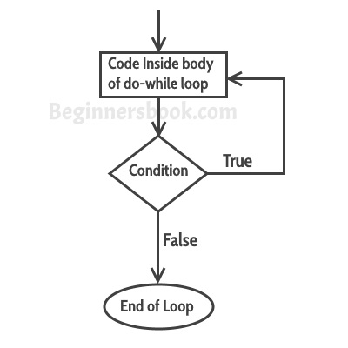
ii)do-while loop
Syntax
variable initialization ;
do
{
statements;
incre/decre;
}while(condition);
Example
void main()
{
int i;
i = 1;
do
{
printf("%d ", i);
i++;
} while(i <= 5);
}
Output: 1 2 3 4 5

Slide 21
iii)for loop
for loop is used to execute a set of statements repeatedly until a particular condition is satisfied.
In for loop we have exactly two semicolons, one after initialization and second after the condition.
In this loop we can have more than one initialization or increment/decrement, separated using comma operator. But it can have only one condition.
The for loop is executed as follows:
    Step-1:It first evaluates the initialization .
    Step-2:Then it checks the condition expression.
    Step-3:If it is true, it executes the for-loop body. When the condition becomes false, it exits the loop.
    Step-4:Then it evaluate the increment/decrement condition and again follows from step 2.

Slide 22
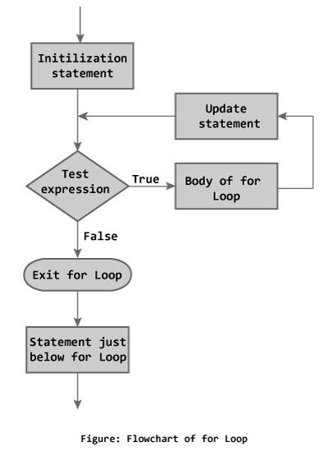
iii)for loop
Syntax
for(initialization; condition; incre/decre)
{
statement-block;
}
Example
void main( )
{
int x;
for(x = 1; x <= 10; x++)
{
printf("%d\t", x);
}
}
Output: 1 2 3 4 5 6 7 8 9 10

Slide 23
Nested for loop
We can also have nested for loops, i.e one for loop inside another for loop.
Syntax
for(initialization; condition;increment/decrement)
{
for(initialization; condition; increment/decrement)
{
statement ;
}
}
Syntax
void main( )
{
for(int i = 1; i <=3; i++)
{
for(int j = 1; j <=i; j++)
{
printf("%i ", i, );
}
}
}
Output:
1
2 2
3 3 3

Slide 24
i) break statement
When a break statement is encountered inside a loop, the loop is immediately terminated and the program control resumes at the next statement following the loop.
Whenever it is encountered in switch-case block, the control comes out of the switch-case.
If you are using nested loops, the break statement will stop the execution of the innermost loop and start executing the next line of code after the block.
syntax: break;

Slide 25
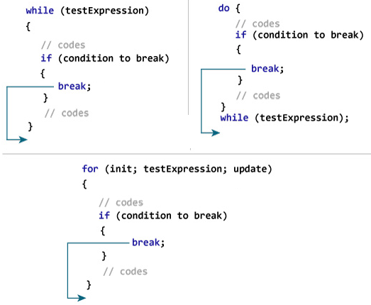
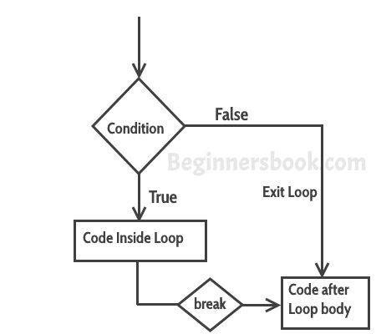
i) break statement
How break statement works? | Flow diagram of break statement

Slide 26
Example – Use of break in a while loop | Example – Use of break in a for loop
int main() { int a =0; while(a<=10) { printf(“%d \n", a); if (a==2) { break; } a++; } printf("Out of while-loop"); } Output: 0 1 2 Out of while-loop | int main() { int i; for (i =10; i>=5; i --) { printf(" %d\n", i); if (i==9) { break; } } printf("Out of for-loop"); } Output: 10 99 Out of for-loop

Slide 27
ii) continue statement
On encountering continue, cursor leave the current cycle of loop, and starts with the next cycle.
The continue statement skips the current iteration of the loop and continues with the next iteration.
syntax: continue;

Slide 28
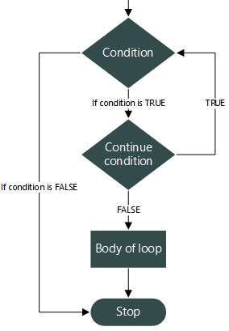
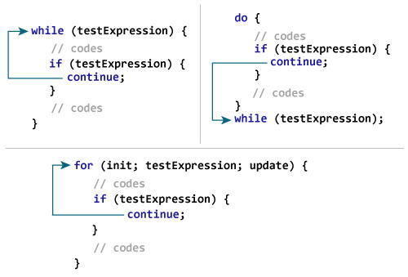
ii) continue statement
How continue statement works? | Flow diagram of continue statement

Slide 29
ii) continue statement
int main() { for (int j=0; j<=8; j++) { if (j==4) { continue; } printf("%d ", j); } return 0; } | Output: 0 1 2 3 5 6 7 8 Value 4 is missing in the output, why? When the value of variable j is 4, the program encountered a continue statement. which makes the control to jump at the beginning of the for loop for next iteration, skipping the statements for current iteration (that’s the reason printf didn’t execute when j is equal to 4).

Slide 30
iii)goto statement
goto is a jumping statement in c language, which transfer the program’s control from one statement to another statement.
goto can transfer the program’s within the same block and there must a label, where you want to transfer program’s control.
Syntax: goto label_name:
label_name should be a identifier name.
(colon) should be used after the label_name.

Slide 31
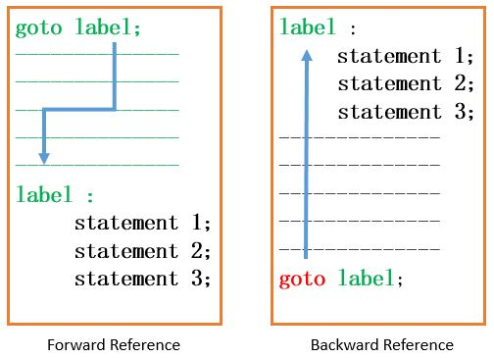
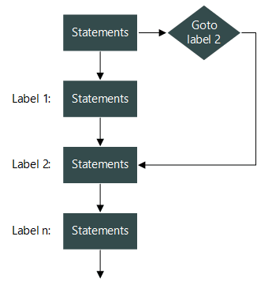
iii)goto: statement

Slide 32
iii)goto: statement
Transferring the control from down to top |  | Transferring the control from top to down
int main() { int a; printf("Enter number: ); scanf("%d",&a); table: printf("%d ",a); a++; if(a<=5) goto table; } | Output: Enter a: 1 1 2 3 4 5 | int main() { int a; printf("Enter a: "); scanf("%d",&a); if(a<=10) goto sai; printf("Number is : %d", a); sai: printf("Bye Bye !!!"); } | Output: Enter a: 1 Bye Bye !!!

Slide 33

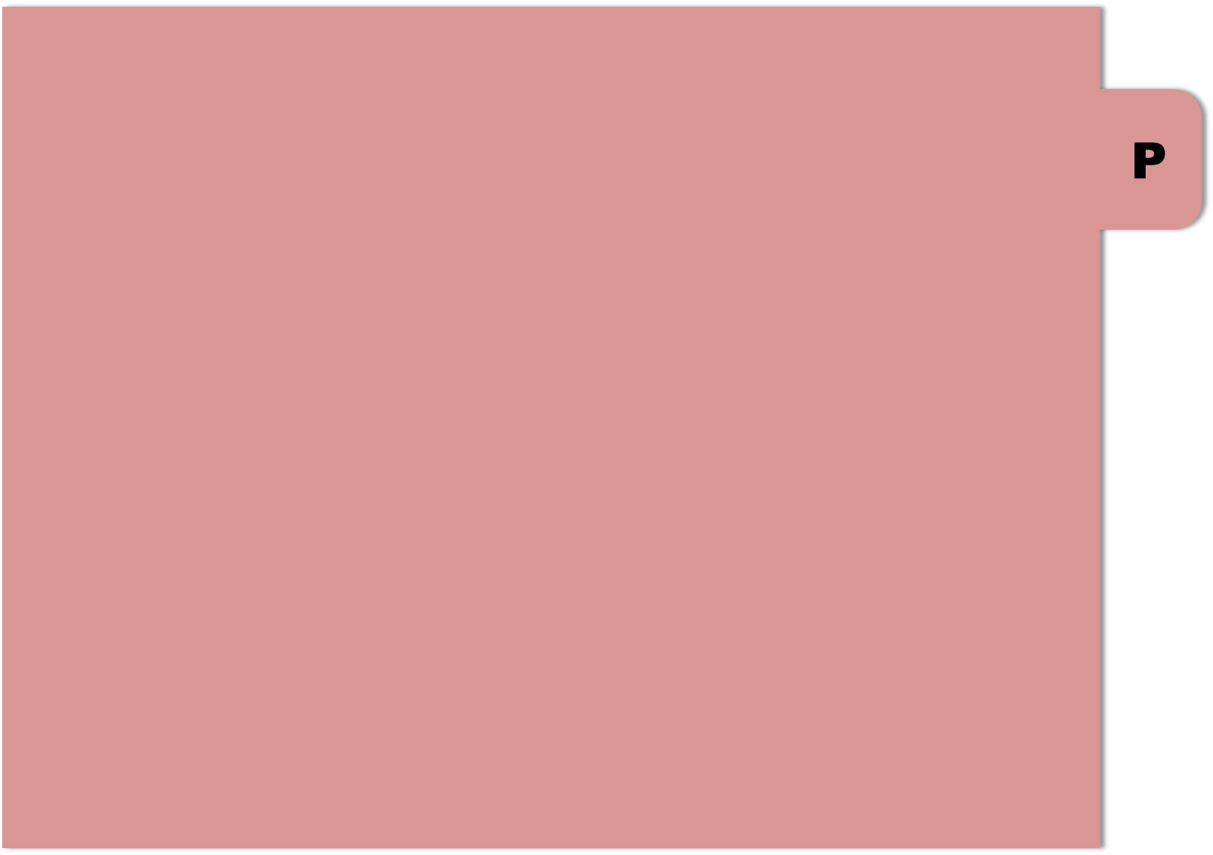

THE END

